Slide 1
WICCI ANGEL INVESTMENT COUNCIL, DELHI
WOMEN´S INDIAN CHAMBER OF COMMERCE AND INDUSTRY
www.wicci.in

Slide 2
Council Vision &Mission
'There is no limit to what we, as women, can accomplish'
WICCI Angel Investment Council aims to promote financial literacy among women. We intend to come up with ways to form an extensive network that would help the council connect entrepreneurs with required resources. We plan on organising seminars, trivia, quizzes and competitions to raise awareness about angel investment and importance of having women entrepreneurs and women investors. We plan on establishing a social media presence to spread awareness about financial terms, basics of investing and intersection of finance and feminism.

Slide 3
Welcoming
Council Members to
WICCI
President, Vice President
and 20+ Nominated Council Members

Slide 4
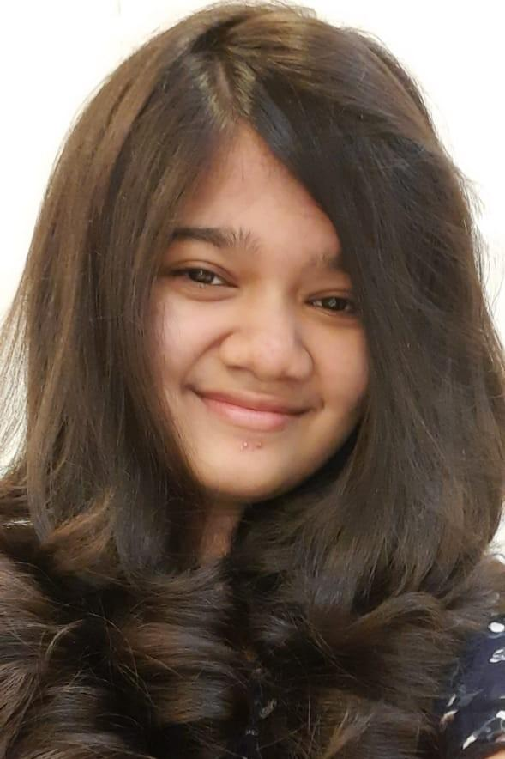
SRISHTI SINGH, STATE PRESIDENT
STATE PRESIDENT, ANGEL INVESTMENT COUNCIL WICCI
BIO :- I am Srishti Singh, a third year student at Delhi University. I am pursuing Economics Hons with a minor in Commerce. Promoting women's rights has always been a central theme in my life. I am a member of Girl Up, a UN organisation where my contribution involved galvanising discussions about intersectional feminism, women in business and STEM. I am extremely passionate about Economics- especially Econometrics and Game Theory. Finance should not be viewed as an esoteric subject because it is a part of our everyday life. Therefore, I firmly believe in promoting financial literacy and independence among women.

Slide 5
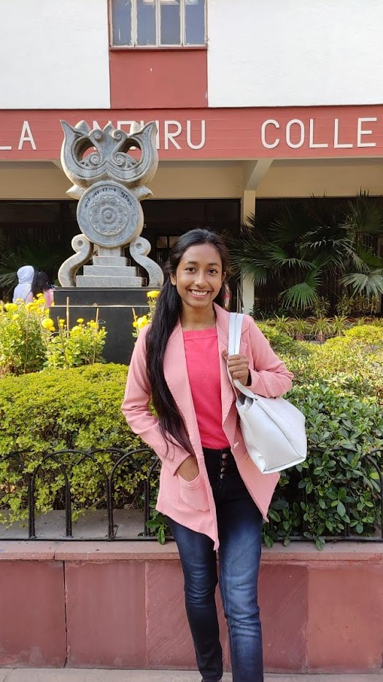
BHAWNA KUMARI, STATE VICE PRESIDENT
STATE VICE PRESIDENT, ANGEL INVESTMENT COUNCIL WICCI
I am Bhawna Kumari. I am currently in my Third Year pursuing B.A. in Economics at the Kamala Nehru College, University of Delhi. I am a creative bookworm with a knack for reading, writing and researching. I am a member of the student council of the Economics Department and the Head of Public Relations of the Women’s Development Cell at KNC. I have interned with The Feminist Times, Break the Ice and Softrate India, Chennai in the capacity of a content writer which has furthered my enthusiasm for spreading awareness by simplified writing.
Insert High Resolution Picture

Slide 6
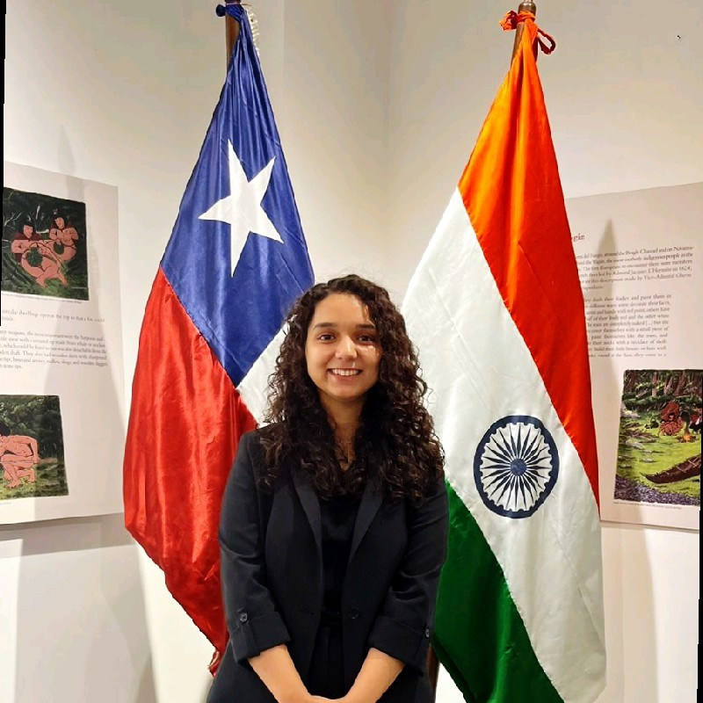
AARUSHI MAHAJAN, MEMBER
COUNCIL MEMBER, ANGEL INVESTMENT COUNCIL WICCI
BIO :-
I am a passionate first-year student pursuing Political Science Honors with a Minor in Economics at Kamala Nehru College, Delhi University.
Empowering women and advocating for equal rights are close to my heart and I have used my love for writing to amplify the voices of underprivileged. I am also a proud member of the Debating Society of KNC and currently delving into the world of research via engagement with RISE cell..
Beyond my academic and professional endeavors, my hobbies include reading, writing, swimming, and cooking.

Slide 7
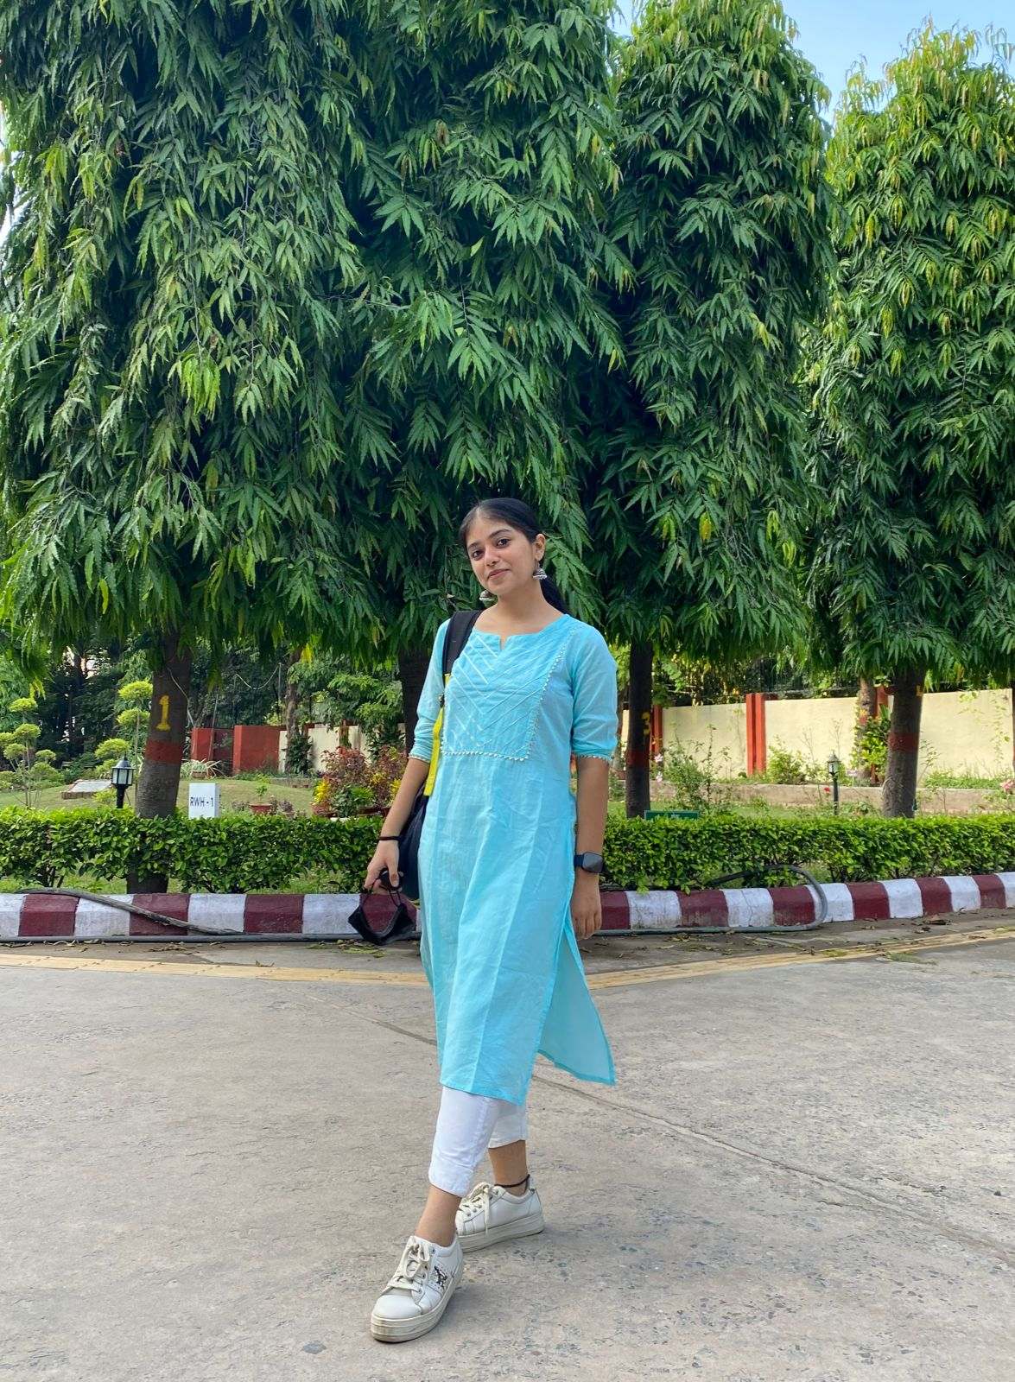
ANUSHKA POKHRIYAL, MEMBER
COUNCIL MEMBER, ANGEL INVESTMENT COUNCIL WICCI
BIO :-
I am a passionate and dedicated student pursuing Political Science Honors at Delhi University, I share a strong drive for success in the fields of research, learning, dance and writing. I believe and have consistently demonstrated a strong work ethic, curiosity, and a thirst for knowledge. I constantly strive for excellence in my studies, embracing challenges as opportunities for growth.

Slide 8
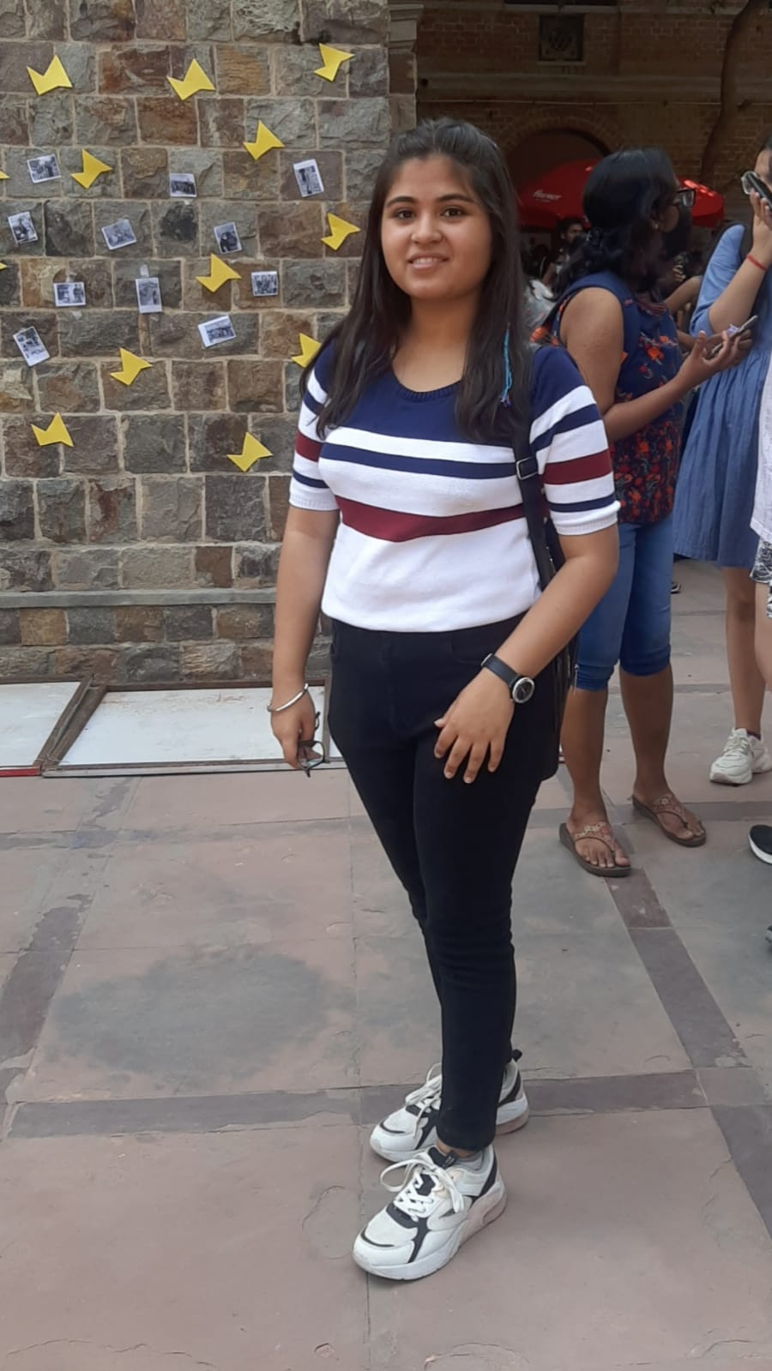
CHELIN NAMDEV, MEMBER
COUNCIL MEMBER, ANGEL INVESTMENT COUNCIL WICCI
BIO :-
My name is Chelin and I am a third-year student of BA honours in economics at Sri Guru Tegh Bahadur Khalsa College Of Delhi University. I am a finance enthusiast and am committed to continuously expanding my knowledge in finance and staying up-to-date with industry trends and best practices. I am committed to contribute to the betterment of the community by supporting women entrepreneurs and professionals.

Slide 9
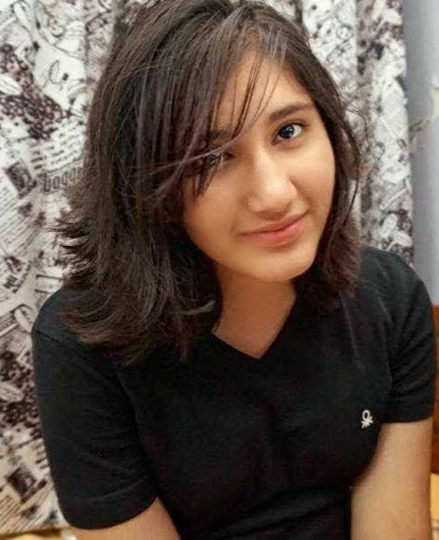
EVA MUKHERJEE, MEMBER
COUNCIL MEMBER, ANGEL INVESTMENT COUNCIL WICCI
BIO :-
I am Eva, a third-year student majoring in Mathematics. Throughout my academic journey, I have gained a deeper understanding of my subject, which has enhanced my problem-solving skills. I strongly believe in the transformative power of education to create endless possibilities. I am passionate about using my knowledge and skills to make a positive impact in the world.
Insert High Resolution Picture

Slide 10
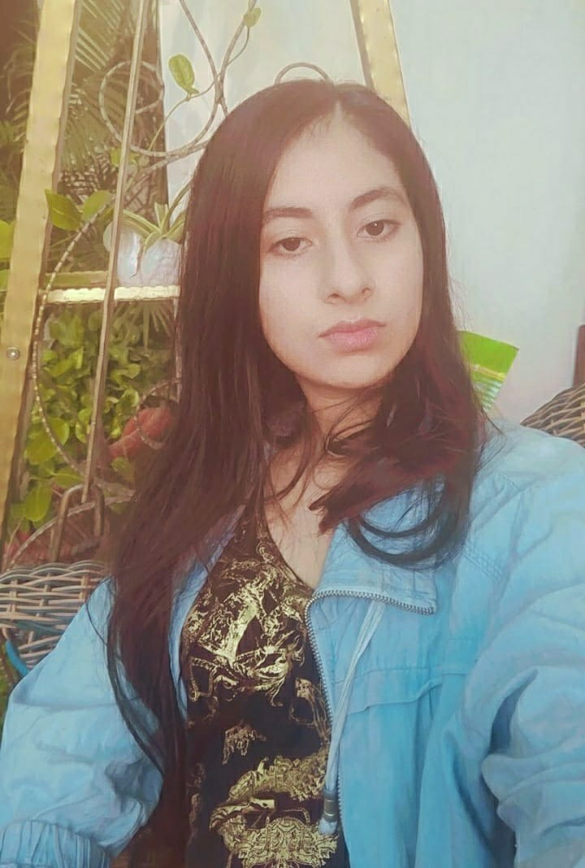
JASNOOR KAUR, MEMBER
COUNCIL MEMBER, ANGEL INVESTMENT COUNCIL WICCI
BIO :-
I’m Jasnoor and I’m in my final year of pursuing economics honours from SGTBKC, DU.
I’ve advocated feminism for as long as i can remember and I’m honoured to get an opportunity to be a part of the council and help empower women, make sure they get their rightful place in the society and contribute to positive inclusive change.

Slide 11
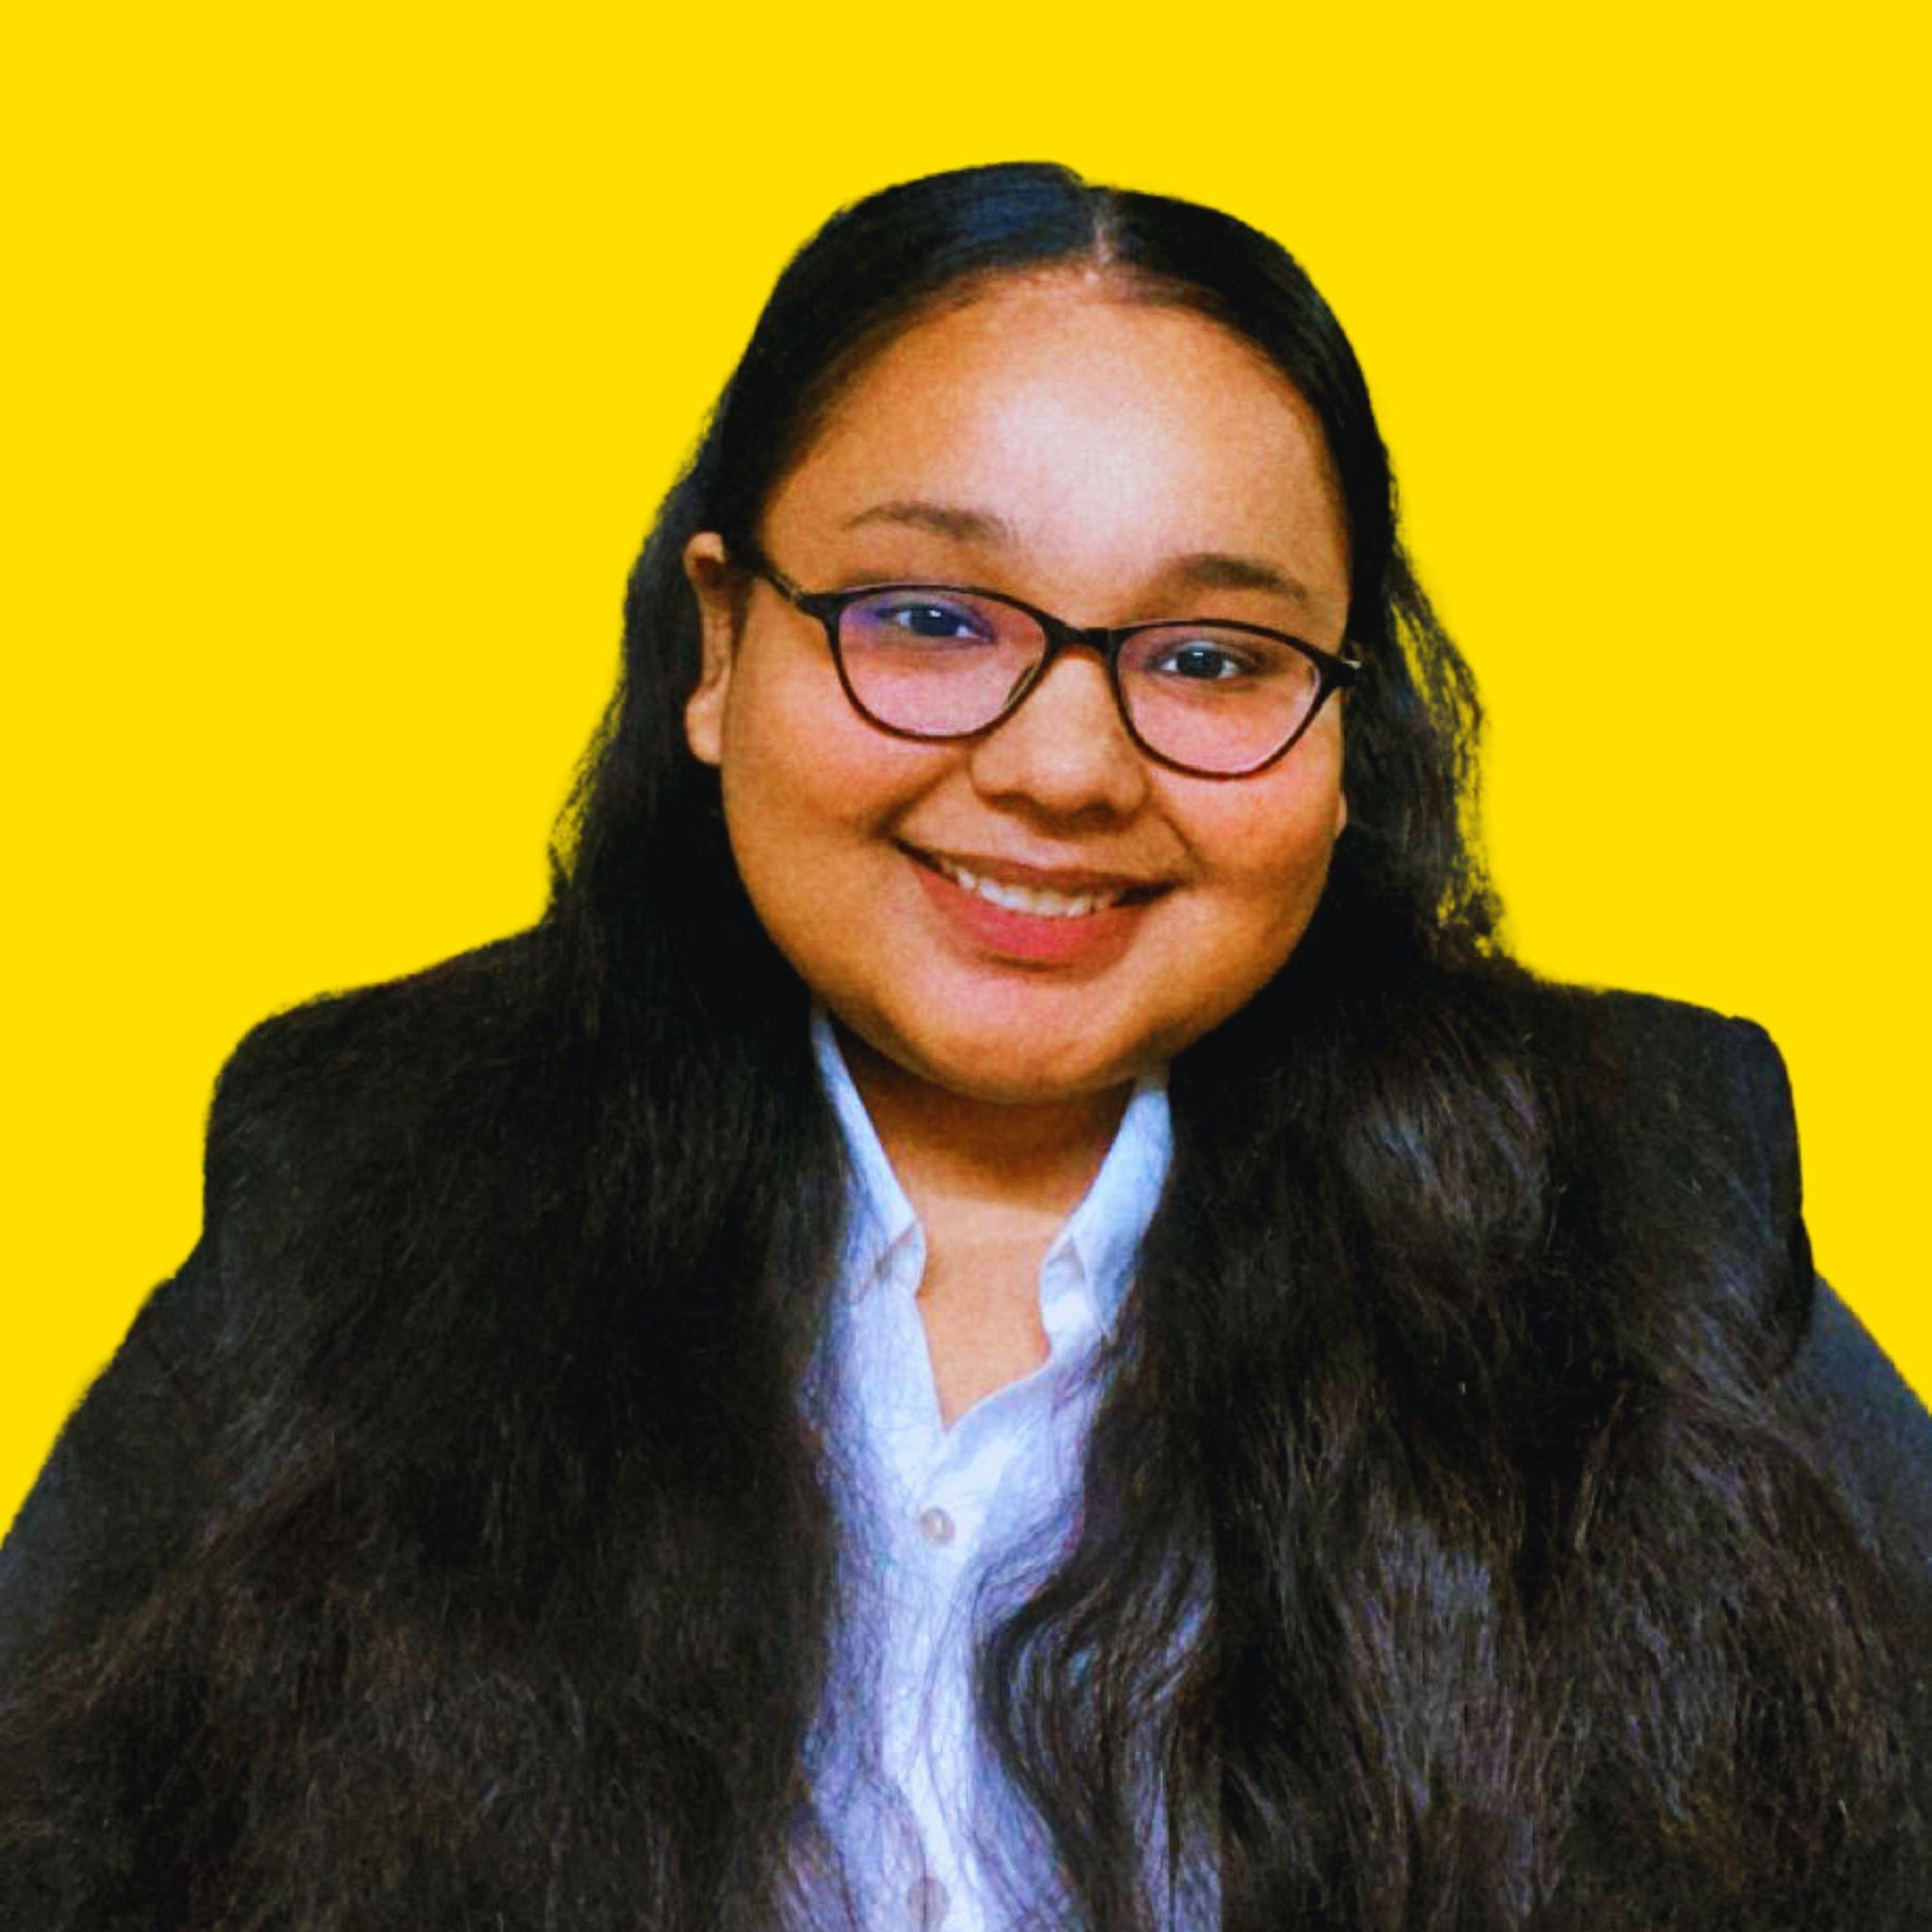
KHUSHI BHANDARI, MEMBER
COUNCIL MEMBER, ANGEL INVESTMENT COUNCIL WICCI
BIO :-
I am a dedicated and ambitious student pursuing a Bachelor's degree in Commerce. With a strong drive for success and a passion for commerce, I have consistently demonstrated a proactive and determined approach to my studies. Throughout my academic journey, I have consistently sought to broaden my knowledge in various facets of commerce, including accounting, finance, marketing, and business management.

Slide 12
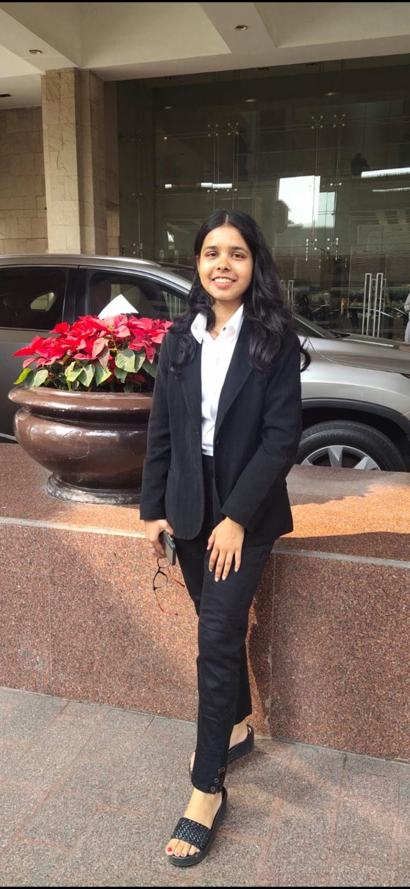
KHUSHI KUMARI, MEMBER
COUNCIL MEMBER, ANGEL INVESTMENT COUNCIL WICCI
BIO :-
I am determined and passionate girl currently pursuing Economics Honours from Delhi university .With a keen interest in understanding the intricate workings of the global economy, i have chosen this field to explore its theories, policies, and practical applications. Along with this i love to engage in extracurricular activities. I want to be a catalyst for positive change in the realm of women’s empowerment.

Slide 13
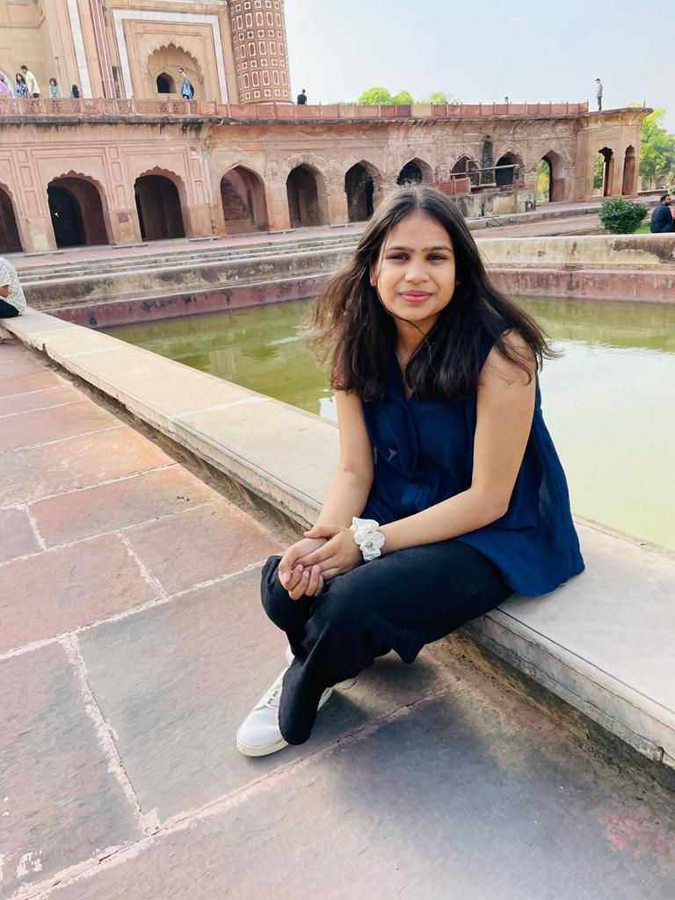
KHUSHI TEKRIWAL, MEMBER
COUNCIL MEMBER, ANGEL INVESTMENT COUNCIL WICCI
I m an enthusiastic college student pursuing bcom. I approach my academics with zeal and drive, and I have a strong sense of passion for what I do. I use my desire to push myself constantly towards excellence.
Insert High Resolution Picture

Slide 14
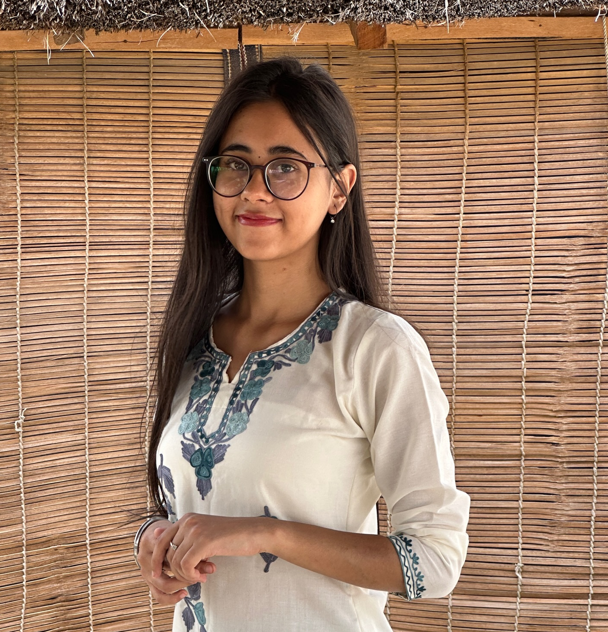
KRINCY KAUR BAGGA, MEMBER
COUNCIL MEMBER, ANGEL INVESTMENT COUNCIL WICCI
BIO :-
I am Krincy, a third year student pursuing a Bachelor’s degree in Commerce. I am a dedicated and ambitious student with a strong drive to broaden my knowledge in the field of commerce. I am punctual, dependable and can be counted upon to finish what I start. Also, I am extremely passionate about developing my skills and personality.
Insert High Resolution Picture

Slide 15
MONALISA GHOSH, MEMBER
COUNCIL MEMBER, ANGEL INVESTMENT COUNCIL WICCI
BIO :-
I'm a easy going, dreamy person who loves to explore whatever life throws at me. I love creativity, from making small DIY projects for home to come with innovative ideas for content in societies, I'm connected with. I'm currently pursuing my History Major from Delhi University and contributing everything I can for the betterment of Womenhood through small measures.
Insert High Resolution Picture

Slide 16
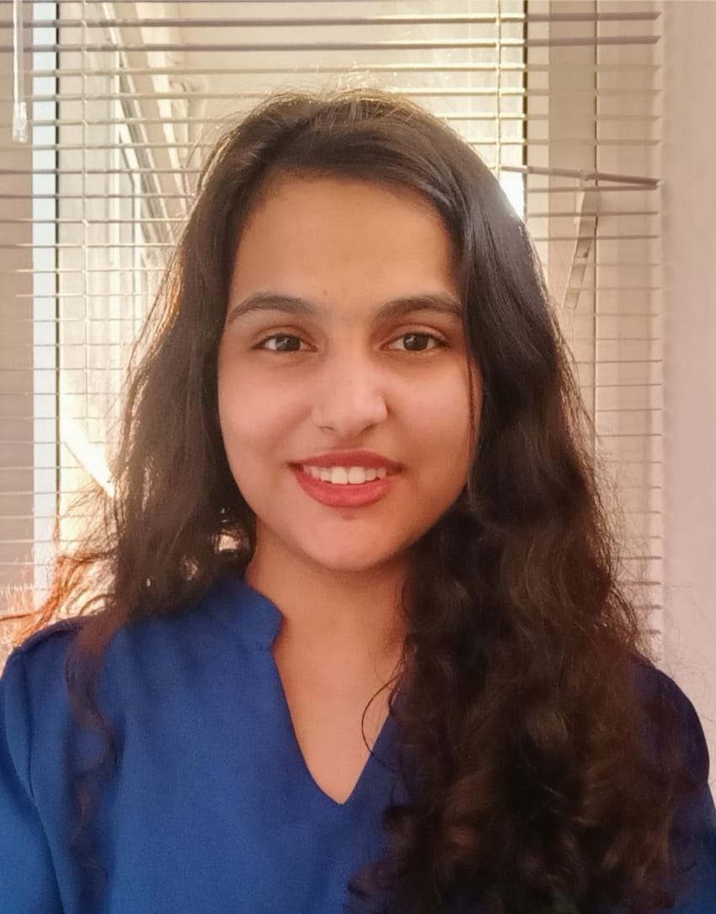
MUSKAAN SAREEN, MEMBER
COUNCIL MEMBER, ANGEL INVESTMENT COUNCIL WICCI
BIO :-
Heyo, it's the coffee addict. I'm a journalism student from Delhi University. I have always felt the need to be cognizant of finances, in every aspect of life, especially young women. It is salient to have a strong base from the get go. That is exactly what I aim to do with this wonderful team. Here's to hoping this journey is as fun for all benefiting from it as it is to us!! Cheers!
Insert High Resolution Picture

Slide 17
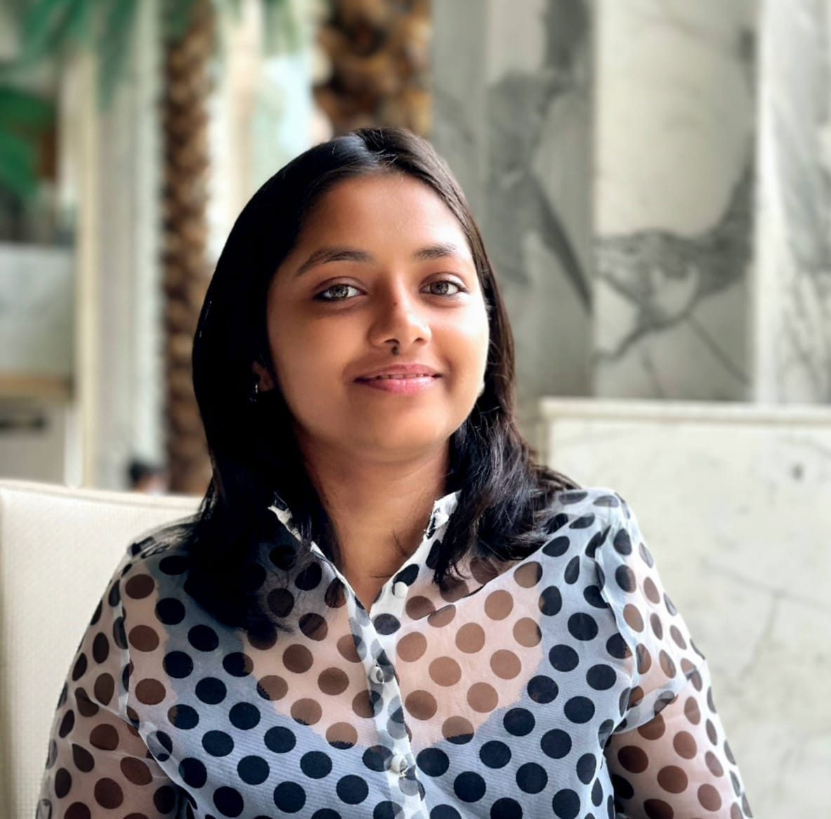
MUSKAN, MEMBER
COUNCIL MEMBER, ANGEL INVESTMENT COUNCIL WICCI
BIO :-
I am Muskan, a third-year student pursuing a B.A. in Economics Honors at Kamala Nehru College, DU. I am enthusiastic about exploring new knowledge and constantly seeking opportunities to learn and grow.
Insert High Resolution Picture

Slide 18
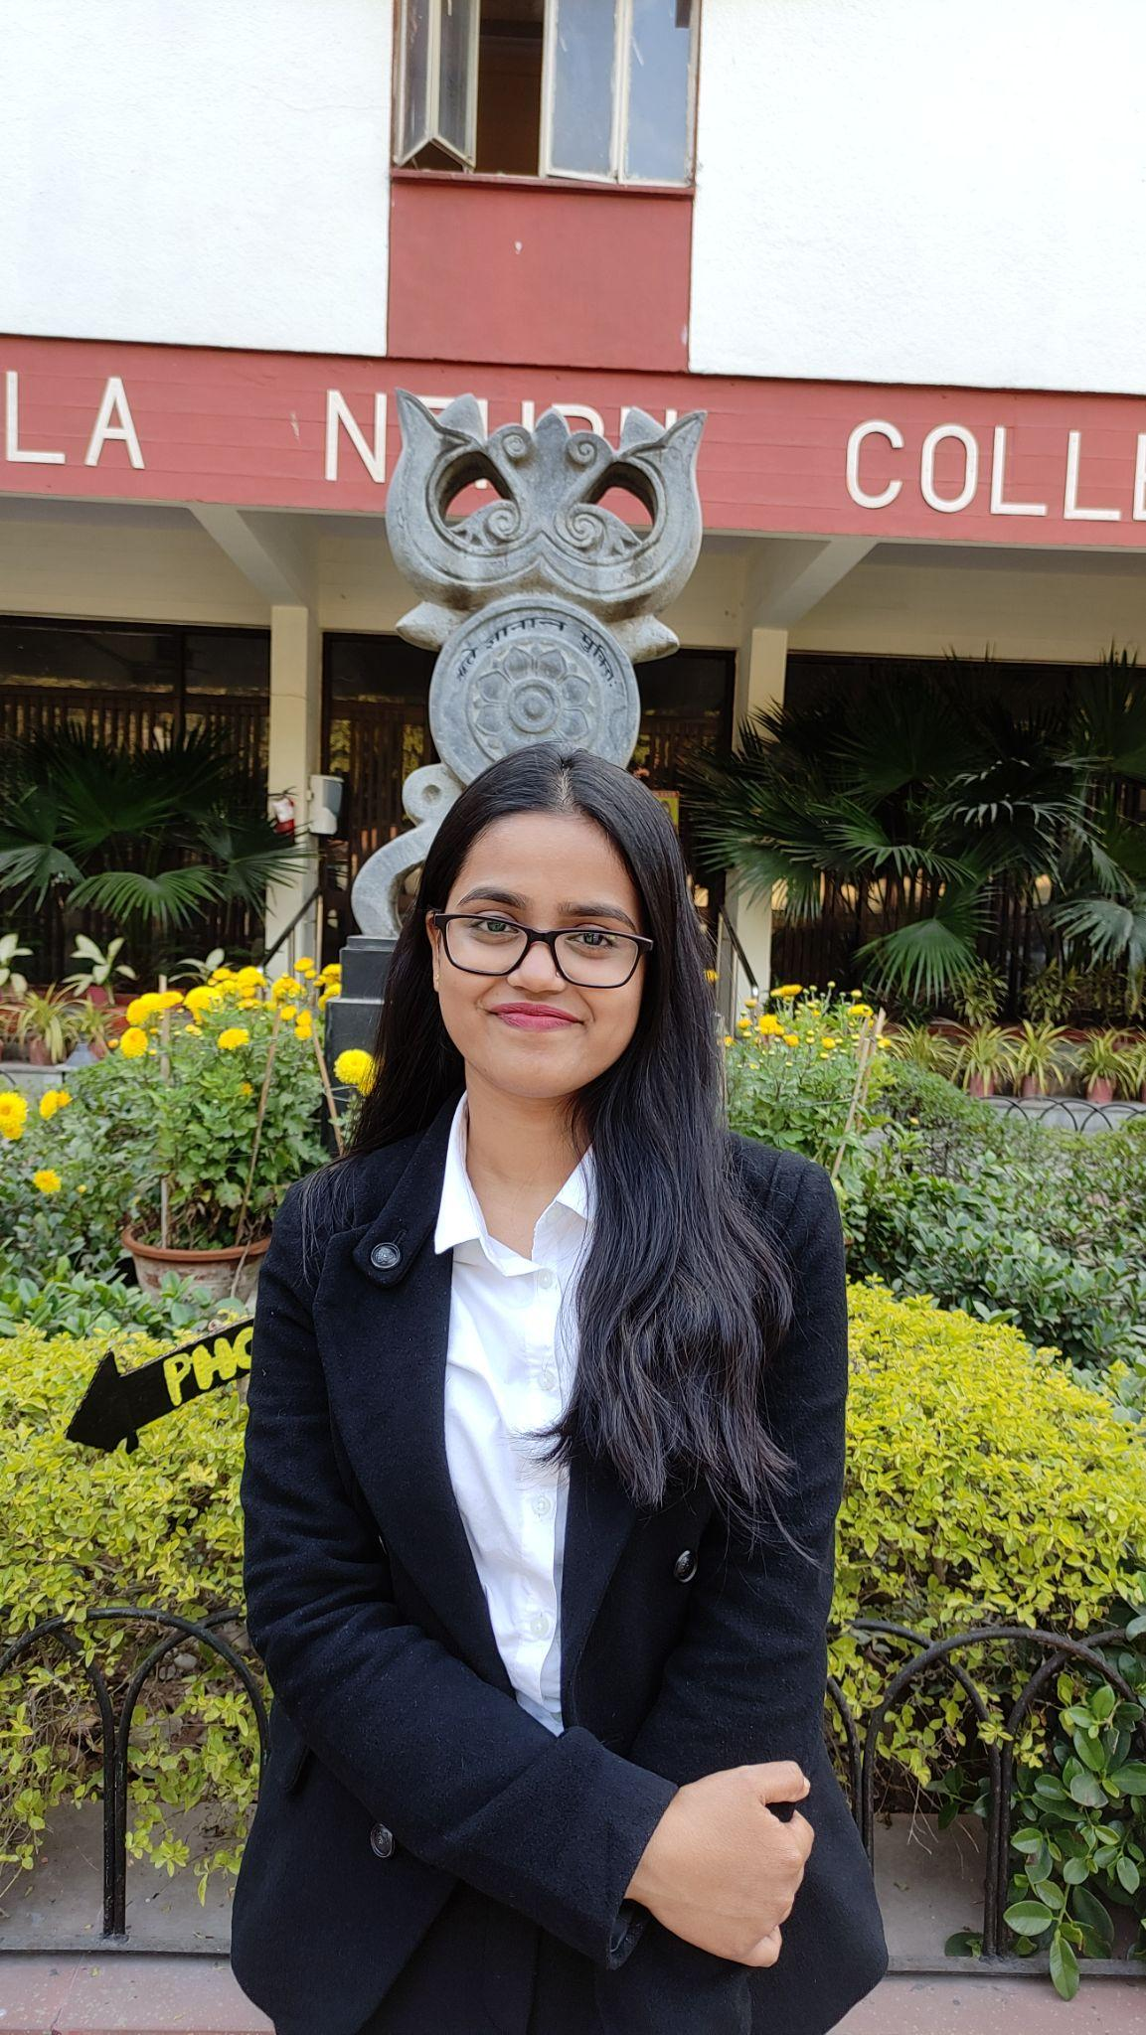
NAJMEEN KHATOON, MEMBER
COUNCIL MEMBER, ANGEL INVESTMENT COUNCIL WICCI
BIO :-
Najmeen is currently the Vice President of The Civil Services Forum of Kamala Nehru College and has also headed the Operations Team of The Department of Economics in her college. She describes herself as a strong-willed, opinionated , determined individual and someone who is always ready to lead a team. She is into planning and executing events , effortlessly bringing people together. She also believes in working towards creating a world where women are given equal opportunities to thrive and succeed.

Slide 19
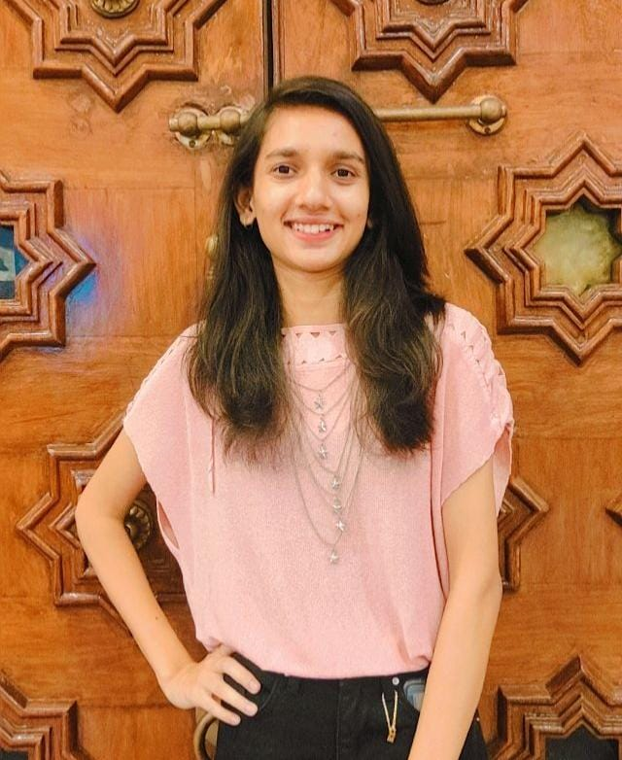
PRAGYA JAIN, MEMBER
COUNCIL MEMBER, ANGEL INVESTMENT COUNCIL WICCI
BIO :-
An Economics enthusiast and a research addict, Majoring in Economics from Hansraj College, University of Delhi. Skilled in Research, Problem Solving, Finance, Strategy, and Marketing.

Slide 20
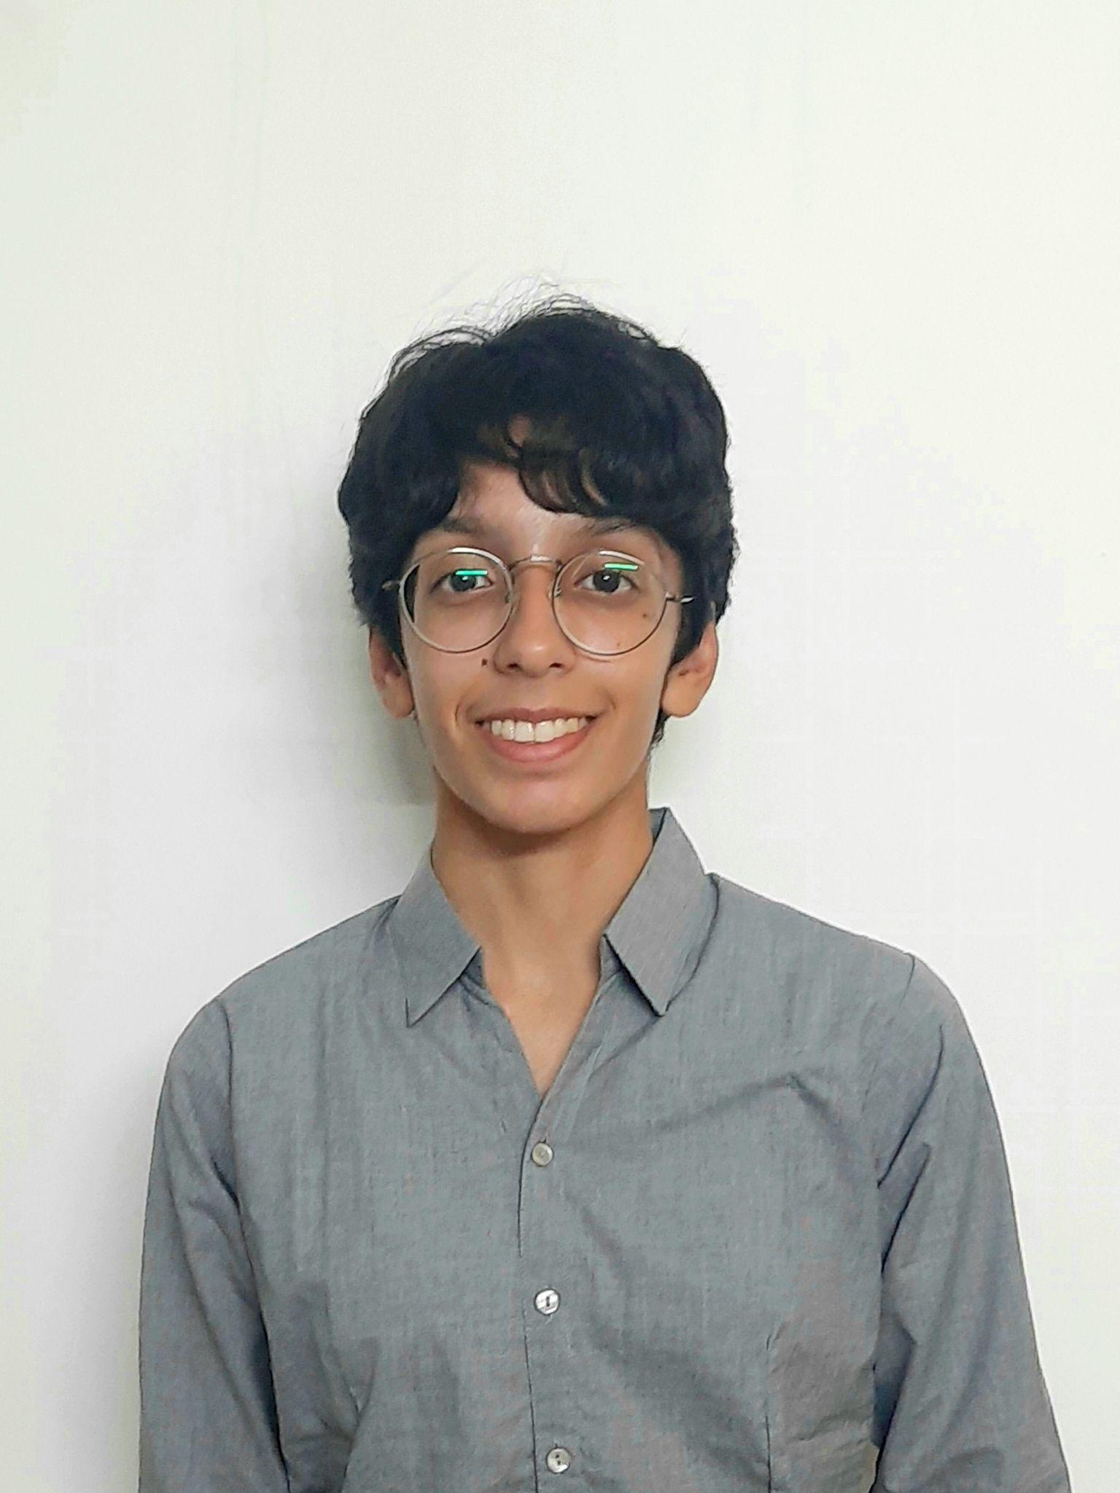
PRAGYA KAPOOR, MEMBER
COUNCIL MEMBER, ANGEL INVESTMENT COUNCIL WICCI
BIO :-
I am Pragya, a third-year student majoring in Economics. I am a Research and Economics enthusiast. My passion lies in the social and environmental sphere, and I wish to do my bit in making society a more aware and proactive space.

Slide 21
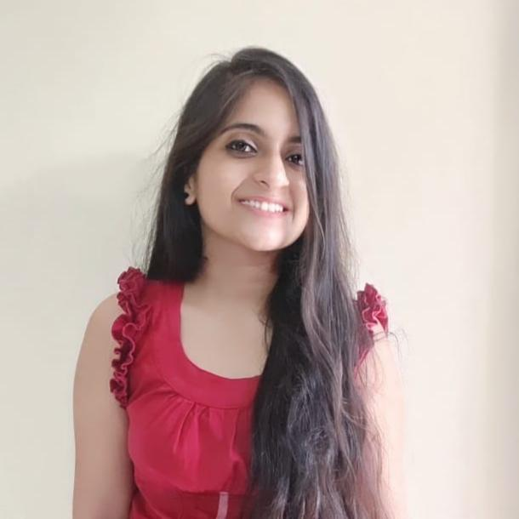
PRATIBHA KALRA, MEMBER
COUNCIL MEMBER, ANGEL INVESTMENT COUNCIL WICCI
BIO
I’m Pratibha kalra, currently pursuing a bachelor's degree in commerce from Kamla Nehru College. I’m kind hearted, introvert with always a book in my bag and at times in my hand. I’m interested in music, psychology, exercise and reading. I’m learning and unlearning my way through life.
~ A believer of good in a world of chaos.~
Insert High Resolution Picture

Slide 22
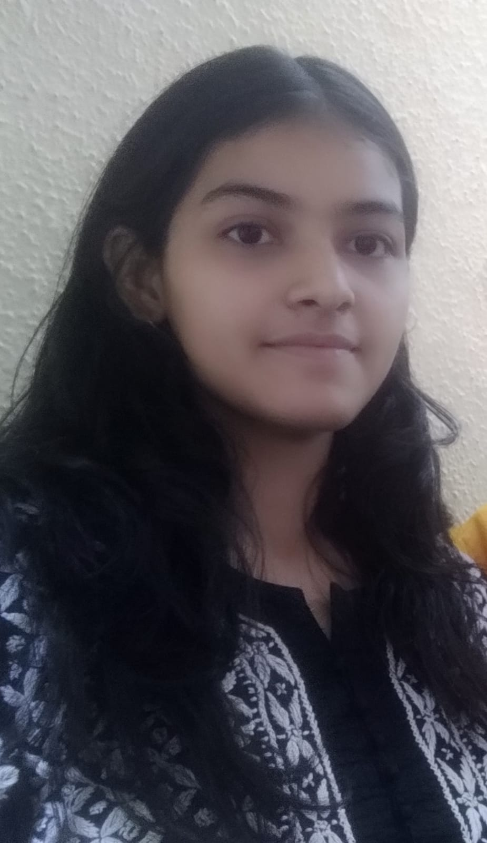
SHIKHA SHARMA, MEMBER
COUNCIL MEMBER, ANGEL INVESTMENT COUNCIL WICCI
v
BIO :-
I am a third year student from Kamla Nehru College majoring in Bachelor in commerce (Honours) involving deep into my subject i have learned about business market , business strategies and lot more keen to perform these skills with high potential. I want to spread awareness in all aspect of society .
I

Slide 23
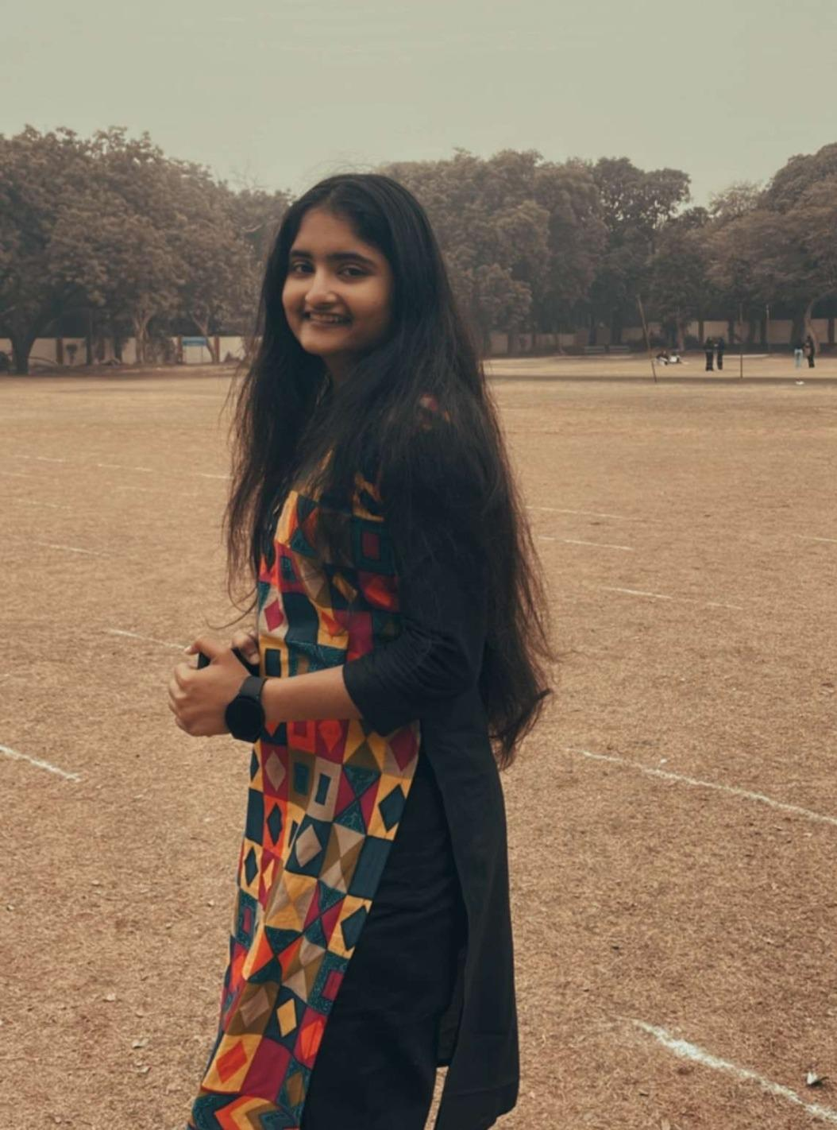
SHREYANKI, MEMBER
COUNCIL MEMBER, ANGEL INVESTMENT COUNCIL WICCI
BIO :-
I am a third- year student at Kamala Nehru College, majoring in History. I firmly believe in equality and feminism. I am currently the Student Representative of Internal Complaints Committee of the College. Everybody knows, if you need someone to talk to, I will be there!
Insert High Resolution Picture

Slide 24
VANISHA MAHENDRU, MEMBER
COUNCIL MEMBER, ANGEL INVESTMENT COUNCIL WICCI
BIO :-
I am Vanisha Mahendru, a third-year student at Kamla Nehru College pursuing a B.com Hons degree. My passion is finance, particularly fund management. I am continually learning about new trends in order to better my decision-making skills. I am passionate about raising awareness about financial and mental health challenges. I worked with two non-profit organisations to which O contributed by writing about mental health and financial literacy. My goal is to make the world a better place to live.

Slide 25
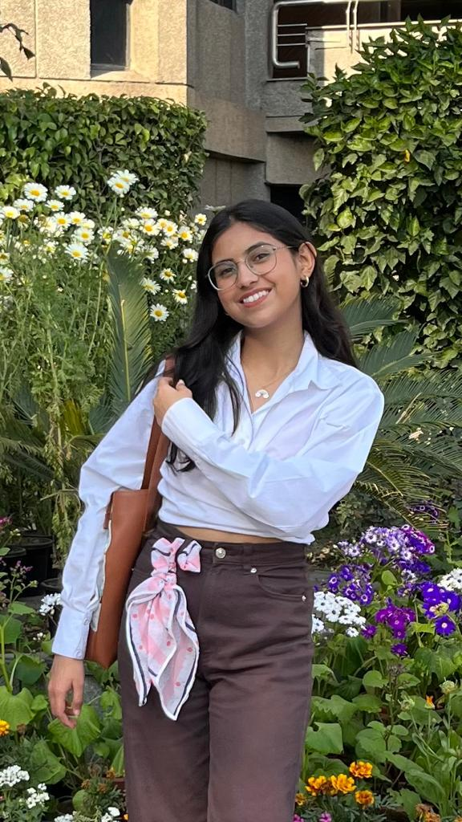
VRINDA RASTOGI, MEMBER
COUNCIL MEMBER, ANGEL INVESTMENT COUNCIL WICCI
BIO :-
I am a student of political science and have a great interest in international politics and policy implementation. I am an enthusiast with a drive for humanistic actions and likes to work towards problem solving. I am very vocal about the issues of the society and like to be part of the change and spread awareness.Throughout my academic journey I have expanded my arenas and gained a deeper understanding of my subject as well as skills like poetry, singing, reading and so much more.
Insert High Resolution Picture

Slide 26
SUPPORTED BY
WICCI is supported by the massive global networks of ALL Ladies League (ALL), Women Economic Forum (WEF), and SHEconomy.
ALL is a movement of ‘Sisters Beyond Borders.’
WEF is a platform for ‘Business Beyond Borders.’ SHEconomy is e-commerce for women worldwide in Goods & Services for ‘Commerce Beyond Borders’

Slide 27
COUNTRIES REPRESENTED
Albania, Angola, Armenia, Argentina, Australia, Azerbaijan, Bangladesh, Brazil, Burundi, Cameroon, Canada, Chad, China, Costa Rica, Croatia, Cyprus, Czech Republic, Colombia, Ecuador, Egypt, Ghana, Germany, Greece, Guatemala, Hong Kong, Hungary, India, Italy, Israel, Ireland, Japan, Kazakhstan, Kenya, Kyrgyzstan, Lesotho, Luxembourg, Malawi, Malaysia, Mexico, Moldova, Monaco, Montenegro, Morocco, Mozambique, Malta, Netherlands, Nigeria, Nepal, New Zealand, North Macedonia, Norway, Paraguay, Portugal, Peru, Puerto Rico, Philippines, Qatar, Romania, Russia, Rwanda, Serbia, Singapore, Slovenia, Spain, South Africa, South Korea, Suriname, Sweden, Switzerland, Syria, Tunisia, Turkey, Uganda, Ukraine, UK, Uruguay, Venezuela, Vietnam, Virgin Islands (US), UAE, USA, Uzbekistan, Zimbabwe.

Slide 28
WOMEN'S INDIAN CHAMBER OF COMMERCE ANDINDUSTRY

